Slide 1
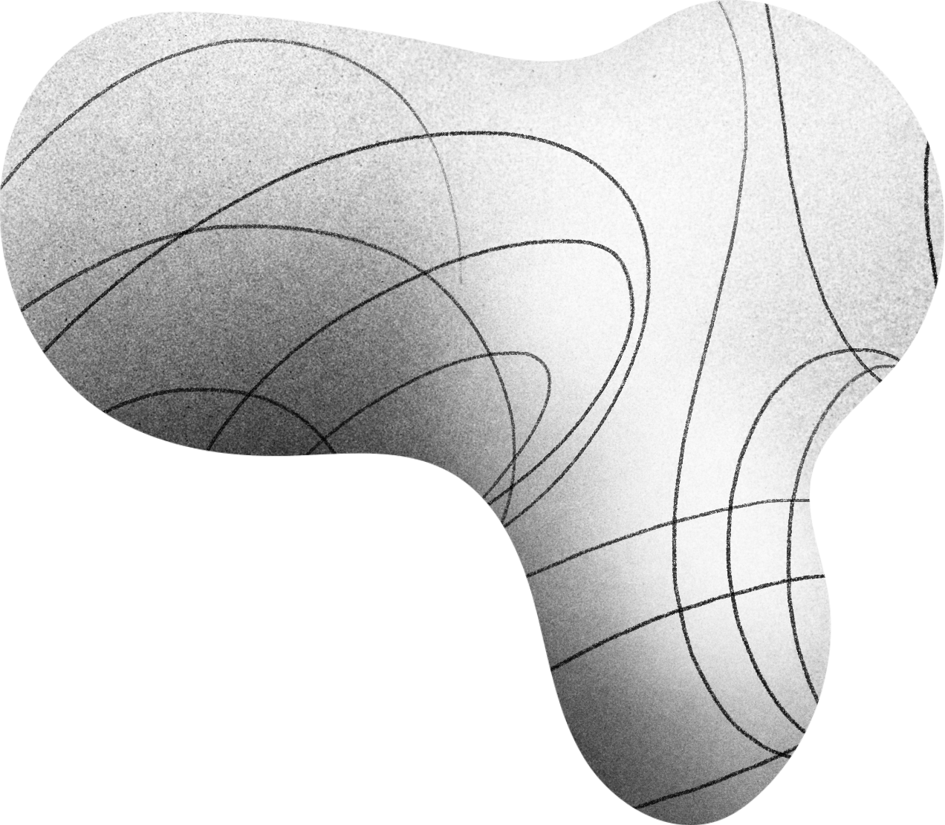

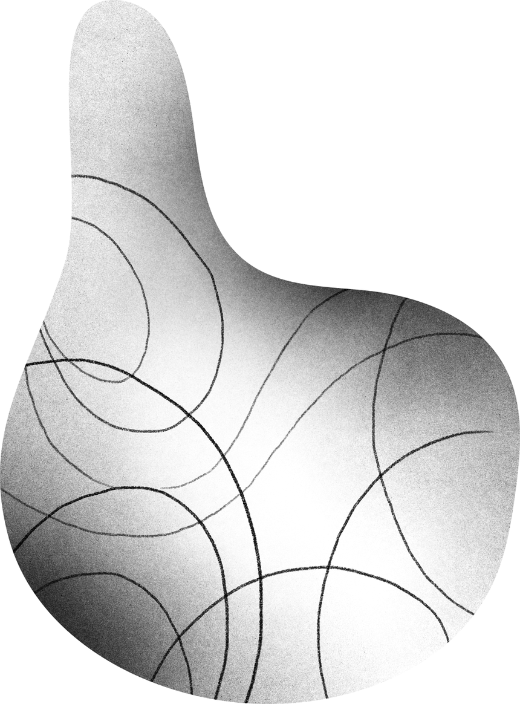
SEIZURE DETECTION USING RL
Group 10
GROUP MEMBERS
Amit Singh (IIT2019045)
Navneet Singh (IIT2019056)
Abhishek Raj (IIT2019058)
Sanidhya Gupta (IIT2019074)
Aastha Singh (IIT2019078)
Ritik Kumar (IIT2019088)
Sumit Katiyar (IIT2019110)

Slide 2
INTRODUCTION
Reinforcement learning is a type of machine learning method where an intelligent agent (computer program) interacts with the environment and learns to act within that.
Agent learns to behave in an environment by performing the actions and seeing the results of actions. For each good action, the agent gets the reward positive feedback, and for each bad action, the agent gets negative feedback or penalty.
Deep Reinforcement learning, which is a combination of deep learning and reinforcement learning. In DRL, value and policy can be expressed by a neural network, which allows it to deal with a continuous state or action

Slide 3
PROBLEM STATEMENT
The focus of our project is seizure prediction, of which we are going to analyze in order to have a clearer and more complete idea of the deep reinforcement learning models potentialities on epileptic seizures data.
The problem of epileptic seizure prediction can be identified as a classification task. Classification is the process of predicting the target associated with each sample in the data.
In this project, the problem of epileptic seizure can be considered a binary classification task, since we want to classify the time steps in two classes, which are the seizure class and the non-seizure class.

Slide 4
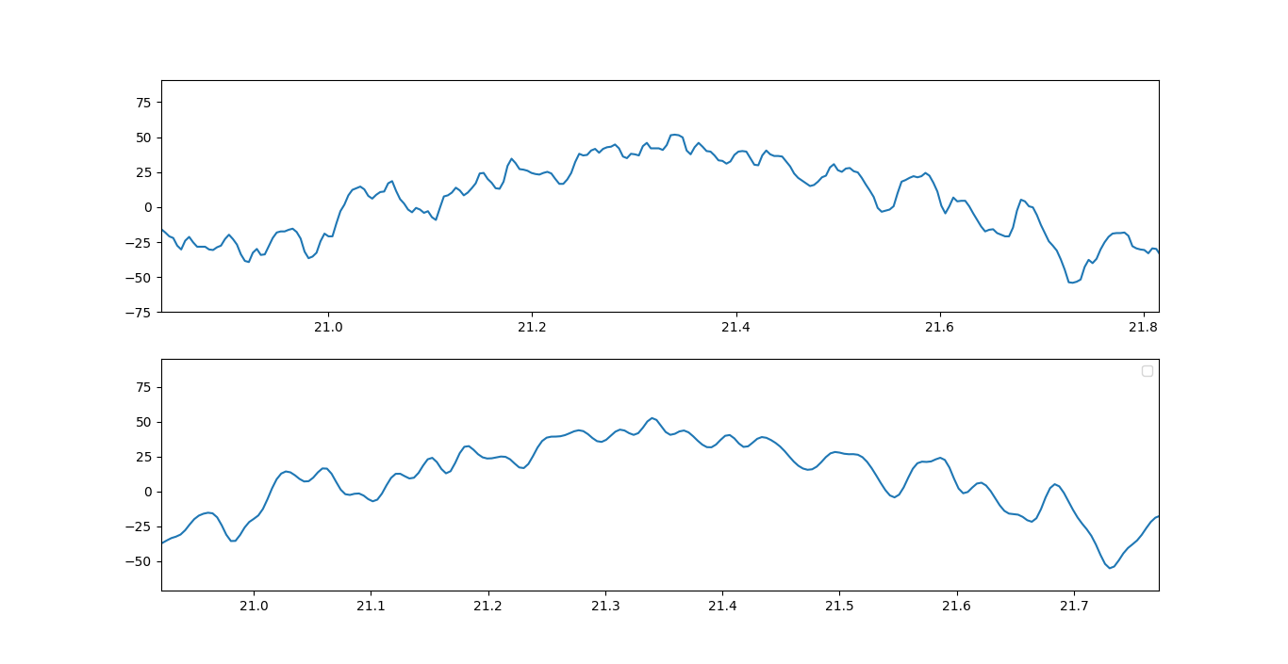
DATASET PRE-PROCESSING
We are using 6th order Butterworth filter for preprocessing our data using cutoff frequency of 45.12 Hz
Here this is the plot of one channel
applying butterworth filter to
smooth the signal

Slide 5


DIVIDING THE DATASET INTO TWO CSV FILES OF SEIZURE AND NON SEIZURE RECORDINGS OF 23 CHANNEL

Slide 6

FEATURE EXTRACTION
A variety of methods have been widely used to extract the features from EEG signals, among these methods are variance, standard deviation ,Shannon entropy and kurtosis.
We mainly calculate four features: variance, standard deviation ,Shannon entropy and kurtosis.Total 23*4 =92 features will be created for segment of every 10 sec ( 10*256 = 2560) signal.
We performed the feature extraction so there are 23 channels in our dataset and recording of 74 *2 = 148 min (8880 sec) for both seizure and non-seizure patients.
So 1136640/2560 = 444 rows will be created for 92 features for seizure data. After extraction 444*92 matix for seizure and 444*92 for non*seizure will be created.

Slide 7
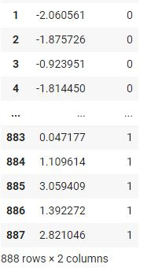
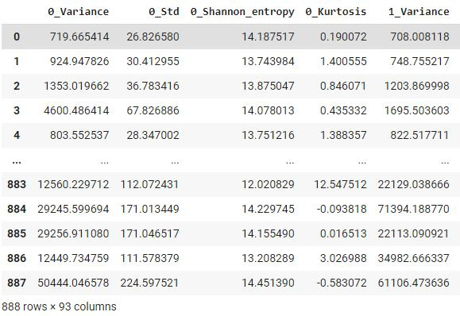

Slide 8
DIMESIONALITY FEATURE REDUCTION METHOD
Here we divide the samples into windows ,four statistical features are extracted from each window. The features are {variance, standard deviation ,Shannon entropy and kurtosis}.
Total Features created=23*4=92 for segment of every 10 sec.
Total rows created for 92 features for seizure data=1136640/2560 = 444
Two matrix will be created : 444*92 matix for seizure and 444*92 for non*seizure .
Now, Performing LDA(linear discriminant analysis) for reducing the 92 features into single feature.

Slide 9
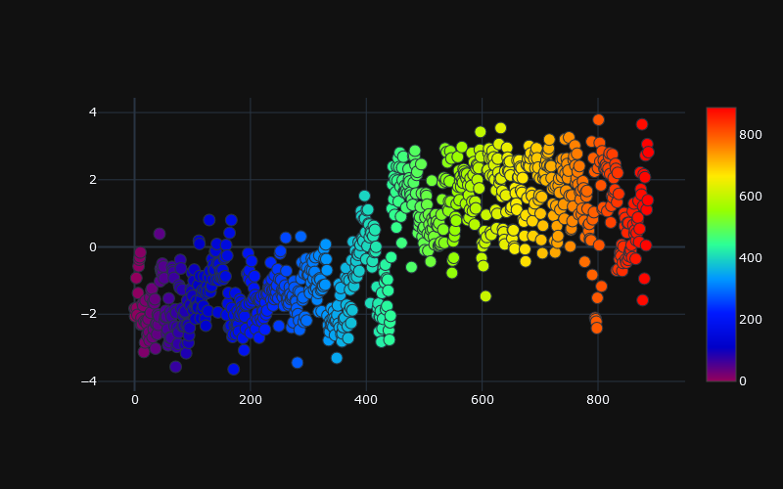
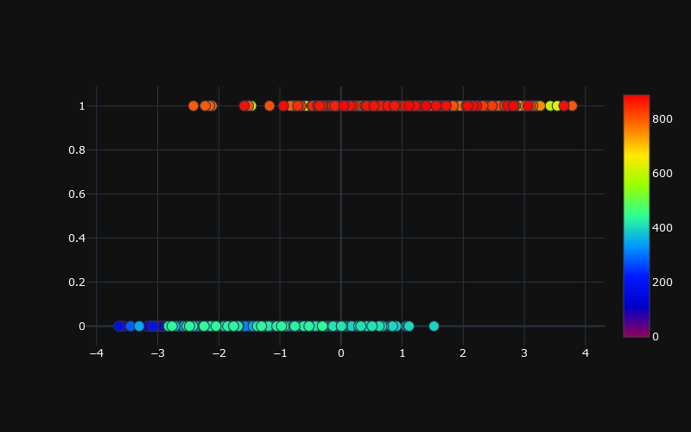

Slide 10
REINFORCEMNT LEARNING
TECHNIQUE TO MAKE MACHINE LEARN TO SOLVE A TASK WITHOUT SUPERVISION
WHEN A TASK IS EXECUTED WE GO THROUGH A NUMBER OF STEPS
AT EACH STEP THE STATE OF SYSTEM CHANGES
BASED ON THAT STATE WE MAKE A DECISION
WE FINALLY GET A REWARD BASED ON SUCCESS/FAILURE OF OUR DECISION CHAIN

Slide 11
THE REINFORCEMENT LEARNING PROCESS
Observation of the environment
Deciding how to act using some strategy
Acting accordingly
Receiving a reward or penalt
Learning from the experiences and refining our strategy
Iterate until an optimal strategy is found

Slide 12
REWARDS
The agent should receive a high positive reward for a successful dropoff because this behavior is highly desired
The agent should be penalized if it tries to drop off a passenger in wrong locations
The agent should get a slight negative reward for not making it to the destination after every time-step. "Slight" negative because we would prefer our agent to reach late instead of making wrong moves trying to reach to the destination as fast as possible

Slide 13
STATE SPACE
In Reinforcement Learning, the agent encounters a state, and then takes action according to the state it's in.
The State Space is the set of all possible situations our taxi could inhabit. The state should contain useful information the agent needs to make the right action.
In our environment there should be 888 total possible states. where n is total episodes.

Slide 14
ACTION SPACE
The State Space is the set of all possible situations our taxi could inhabit. The state should contain useful information the agent needs to make the right action.
In out case, we can perform only two action,s either having seizure aur non-seizure.

Slide 15
DEEP Q -LEARNING
DEEP REINFORCEMENT LEARNING (DRL) APPROACH WHICH WE ARE GOING TO USE IN OUR MODEL WHICH IS A COMBINATION OF DEEP LEARNING AND REINFORCEMENT LEARNING. IN DRL, VALUE AND POLICY CAN BE EXPRESSED BY A NEURAL NETWORK, WHICH ALLOWS IT TO DEAL WITH A CONTINUOUS STATE OR ACTION.
DEEP REINFORCEMENT LEARNING APPROACH IS USED FOR ELIMINATING NOISY DATA AND LEARNING BETTER FEATURES, WHICH MADE A GREAT IMPROVEMENT IN CLASSIFICATION PERFORMANCE.

Slide 16
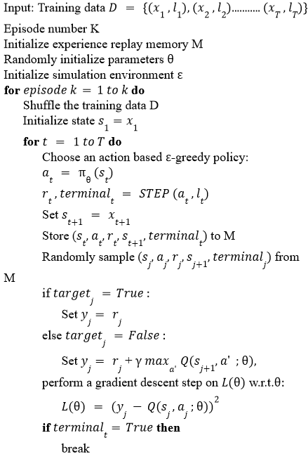
DEEP Q-LEARNING
ALGORITHM

Slide 17
TRAIN AGENT
Create Q-table :
we create a q-table or matrix that follows the shape of [state, action]
we initialize our values to zero.
We then update and store our q-values after an episode. T
This q-table becomes a reference table for our agent to select the best action based on the q-value.
import numpy as np
# Initialize q-table values to 0
Q = np.zeros((state_size, action_size))

Slide 18
Q-LEARNING AND MAKING UPDATES
THE NEXT STEP IS SIMPLY FOR THE AGENT TO INTERACT WITH THE ENVIRONMENT AND MAKE UPDATES TO THE STATE ACTION PAIRS IN OUR Q-TABLE Q[STATE, ACTION]
AN AGENT INTERACTS WITH THE ENVIRONMENT IN 1 OF 2 WAYS
EXPLOITATION
EXPLORATION

Slide 19
EXPLOITATION
The first is to use the q-table as a reference and view all possible actions for a given state. The agent then selects the action based on the max value of those actions. This is known as exploiting since we use the information we have available to us to make a decision.
EXPLORATION
TThe second way to take action is to act randomly. This is called exploring. Instead of selecting actions based on the max future reward we select an action at random. Acting randomly is important because it allows the agent to explore and discover new states that otherwise may not be selected during the exploitation process.

Slide 20
You can balance exploration/exploitation using epsilon (ε) and setting the value of how often you want to explore vs exploit.
import random
# Set the percent you want to explore
epsilon = 0.2
if random.uniform(0, 1) < epsilon:
Explore: select a random action
else:
Exploit: select the action with max value (future reward)

Slide 21
UPDATING THE Q-TABLE
HERE ARE THE 3 BASIC STEPS:
AGENT STARTS IN A STATE (S1) TAKES AN ACTION (A1) AND RECEIVES A REWARD (R1)
AGENT SELECTS ACTION BY REFERENCING Q-TABLE WITH HIGHEST VALUE (MAX) OR BY RANDOM (EPSILON, Ε)
UPDATE Q-VALUES
FOR UPDATING Q TABLE WE USE BELLMON - EQUATION
Q[STATE, ACTION] = Q[STATE, ACTION] + LR * (REWARD + GAMMA * NP.MAX(Q[NEW_STATE, :]) — Q[STATE, ACTION])

Slide 22
LEARNING RATE:
LR OR LEARNING RATE, OFTEN REFERRED TO AS ALPHA OR Α, CAN SIMPLY BE DEFINED AS HOW MUCH YOU ACCEPT THE NEW VALUE VS THE OLD VALUE. ABOVE WE ARE TAKING THE DIFFERENCE BETWEEN NEW AND OLD AND THEN MULTIPLYING THAT VALUE BY THE LEARNING RATE. THIS VALUE THEN GETS ADDED TO OUR PREVIOUS Q-VALUE WHICH ESSENTIALLY MOVES IT IN THE DIRECTION OF OUR LATEST UPDATE.
GAMMA:
GAMMA OR Γ IS A DISCOUNT FACTOR. IT’S USED TO BALANCE IMMEDIATE AND FUTURE REWARD. FROM OUR UPDATE RULE ABOVE YOU CAN SEE THAT WE APPLY THE DISCOUNT TO THE FUTURE REWARD. TYPICALLY THIS VALUE CAN RANGE ANYWHERE FROM 0.8 TO 0.99.

Slide 23
Reward:
reward is the value received after completing a certain action at a given state. A reward can happen at any given time step or only at the terminal time step.
Max:
np.max() uses the numpy library and is taking the maximum of the future reward and applying it to the reward for the current state. What this does is impact the current action by the possible future reward. This is the beauty of q-learning. We’re allocating future reward to current actions to help the agent select the highest return action at any given state.

Slide 24
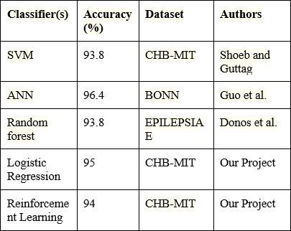
Comparison
Shown a comparison table to understand the advantages of the proposed approach in the seizure detection task.

Slide 25
References
AMIT KUKKER,RAJNEESH SHARMA,”A GENETIC ALGORITHM ASSISTED FUZZY Q-LEARNING EPILEPTIC SEIZURE CLASSIFIER”,PUBLISHED IN EIE DEPARTMENT ,PATIALA,INDIA, JUNE 2021.
ALEXANDROS T.TZALLAS ET AL.,”AUTOMATED EPILEPTIC SEIZURE DETECTION METHODS:A REVIEW STUDY '',ANALYSIS IN UNIVERSITY OF IOANNINA, IOANNINA,GREECE,MARCH 2020.
MOHAMMD KHUBEB SIDDIQUI ET AL.,”A REVIEW OF EPILEPTIC SEIZURE DETECTION USING MACHINE LEARNING CLASSIFIERS” PUBLISHED ONLINE IN BRAIN INFORMATICS ,25 MAY 2020
ALESSIA RUGGERI,”PREDICTION OF EPILECTIC SEIZURES USING MACHINE LEARNING AND DEEP LEARNING MODELS”,THESIS IN UNIVERSITÀ DELLA SVIZZERA ITALIANA,ITALY,SEPTEMBER 2019
MUFTI MAHMUD ET AL., “APPLICATIONS OF DEEP LEARNING AND REINFORCEMENT LEARNING TO BIOLOGICAL DATA”,PUBLISHED IN IEEE TRANSACTIONS ON NEURAL NETWORKS AND LEARNING SYSTEMS,ITALY,6 JUNE 2018.
MENGNI ZHOU ET AL., “EPILEPTIC SEIZURE DETECTION BASED ON EEG SIGNALS AND CNN” ANALYSIS IN TAIYUAN UNIVERSITY OF TECHNOLOGY,TAIYUAN ,CHINA, 10 DECEMBER 2018.
A. ULATE CAMPUS,”AUTOMATED SEIZURE DETECTION SYSTEM AND THEIR EFFECTIVENESS FOR EACH TYPE OF SEIZURE”,ANALYSIS IN DEPARTMENT OF CHILD NEUROLOGY,SPAIN,17 JUNE 2016.
TURKEY N ALOTAIBY ET AL.,”EEG SEIZURE DETECTION AND PREDICTION ALGORITHMS: A SURVEY” IN EURASIP JOURNAL ON ADVANCES IN SIGNAL PROCESSING,ARTICLE NUMBER:183, 2014.
ALI SHOEB,JOHN GUTTAB,”APPLICATION OF MACHINE LEARNING TO EPILEPTIC SEIZURE DETECTION” ANALYSIS IN MASSACHUSETTS INSTITUTE OF TECHNOLOGY, CAMBRIDGE, MASSACHUTTS, MARCH 2011.
J. GOTMAN ,”AUTOMATIC SEIZURE DETECTION :IMPROVEMENTS AND EVALUATION” ,ANALYSIS IN MCGILL UNIVERSITY, CANADA,19 MARCH 2003

Slide 26
Thank
you!

